Slide 1

2054
Interior Design
Interior Design
Modern Minimal
Pitch Deck
Modern Minimal
Pitch Deck
LARANA, INC.

Slide 2
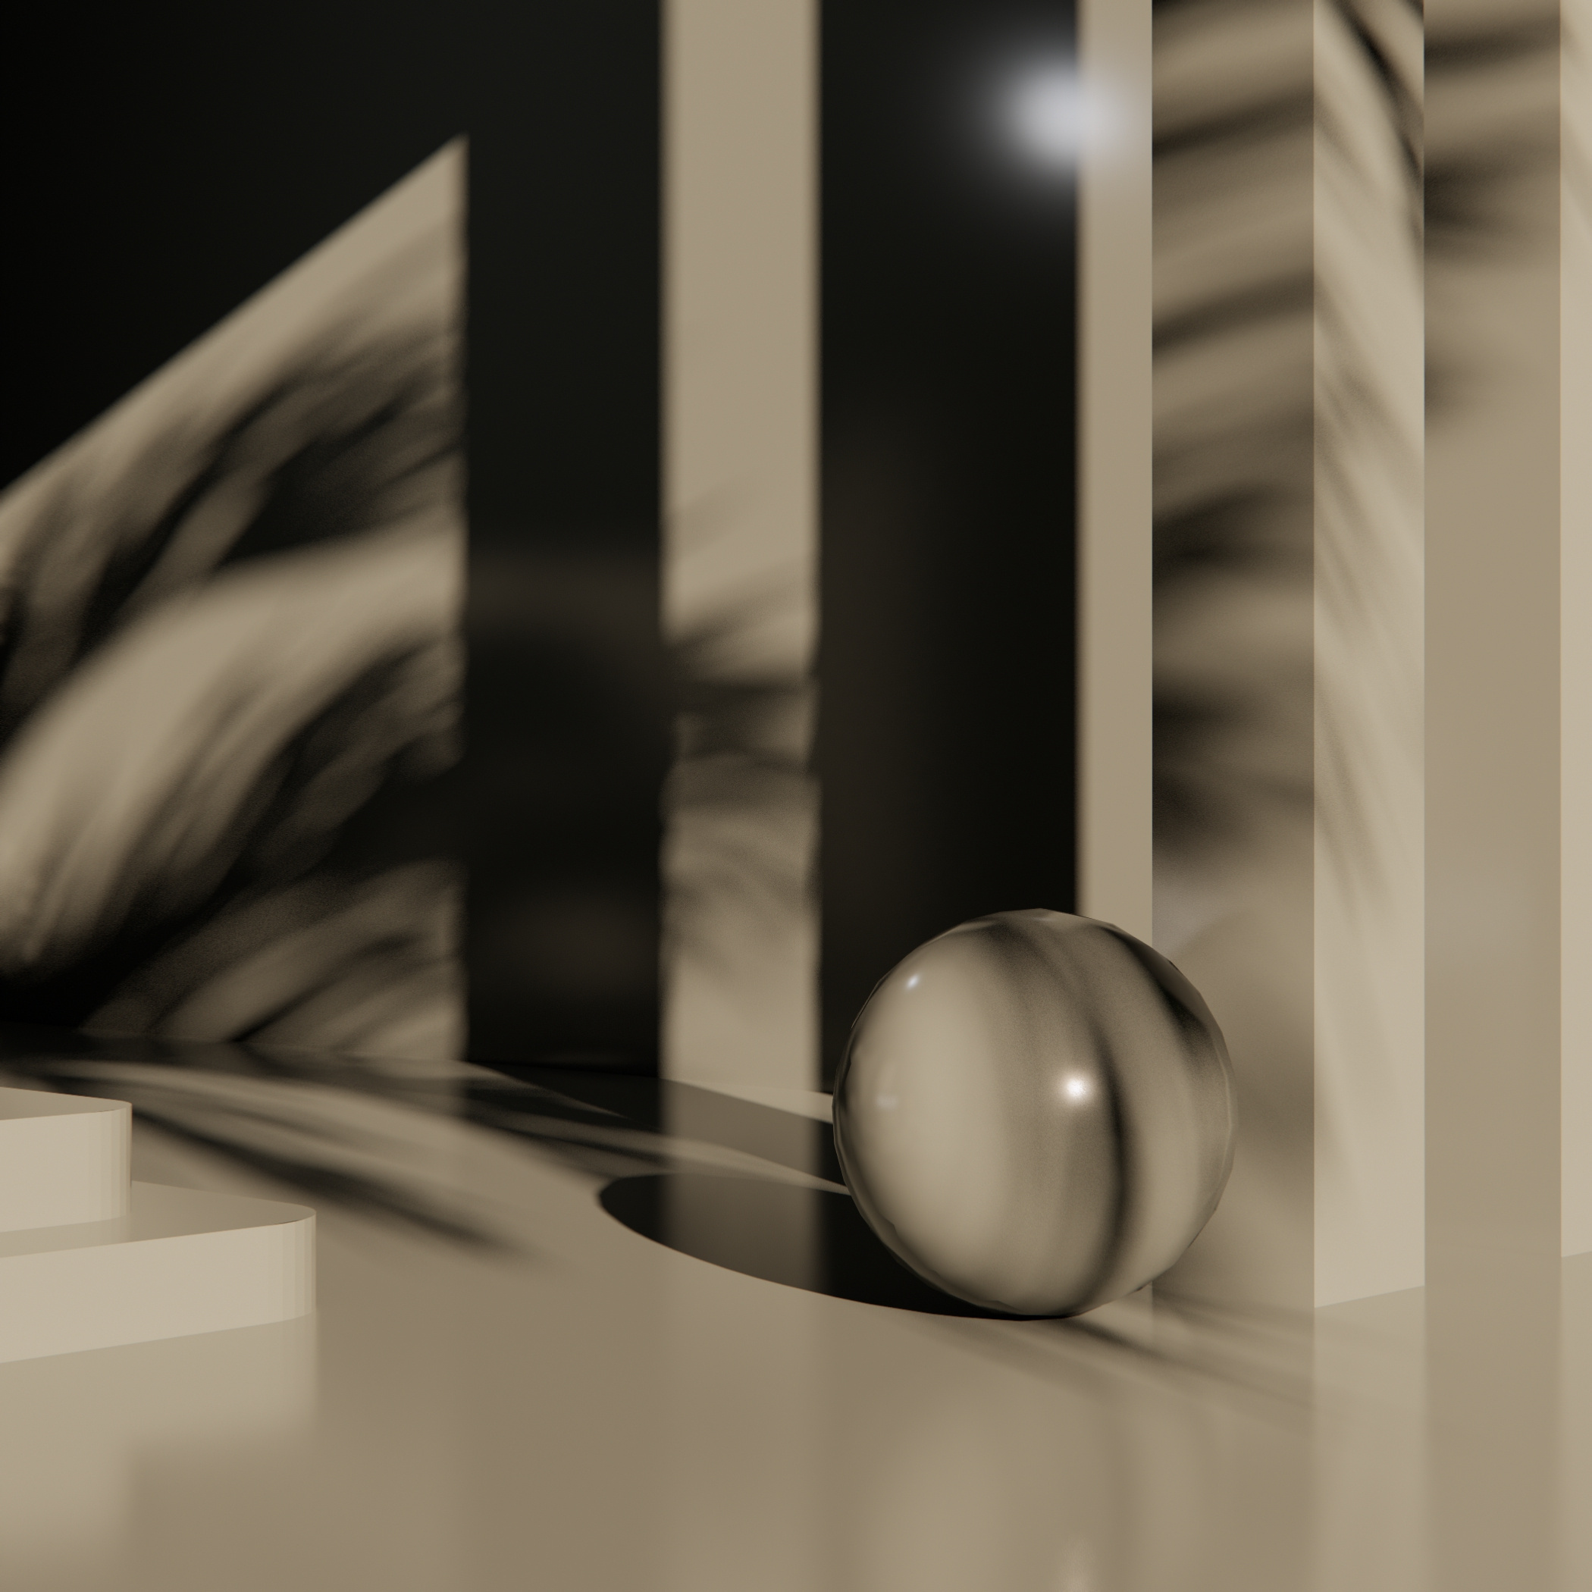
LARANA INC.
2054
Introduction
Larana, Inc. is an interior design
firm established in 1956 in Stockholm, Sweden.

Slide 3
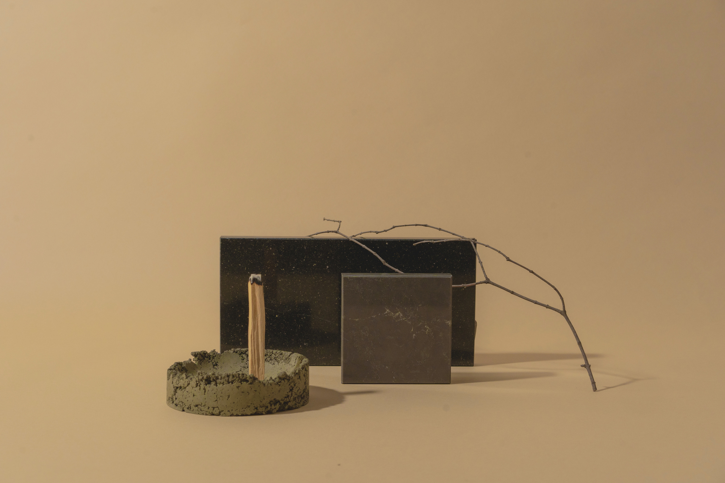
LARANA, INC.
2054
2054
Table Of Contents
Who we are
What we do
Highlights
Project portfolio
How we work
Price list
Meet our team
Get in touch
01
02
03
04
05
06
07
08
A harmonious blend of Scandinavian and Italian interior design traditions, our style combines the minimal, nature-inspired clarity of the North with the ultra premium textures, warmth, and expressive elegance of the South.

Slide 4

LARANA, INC.
2054
2054
01 About Us
We believe in the positive impact interior design has on our well- being, creativity, and productivity. We create sustainable design solutions suited to home and office spaces, big and small. What makes us unique is our blend of Scandinavian and Italian tastes and practical experience. By working with some of Italy's best architects and designers, we've been able to combine Scandinavian simplicity with more verbose Italian aesthetics to create a truly singular approach to interior design.
Our comprehensive services include finding the perfect color palette, textiles, carpets, furniture, and lighting to suit your space. We also provide room planning, a full selection of materials, and project management to guide you through the process from start to finish. Over the years, we've built great relationships with architects and builders with whom we work together on each project, giving our clients a full-service design team to plan and design your dream home.

Slide 5
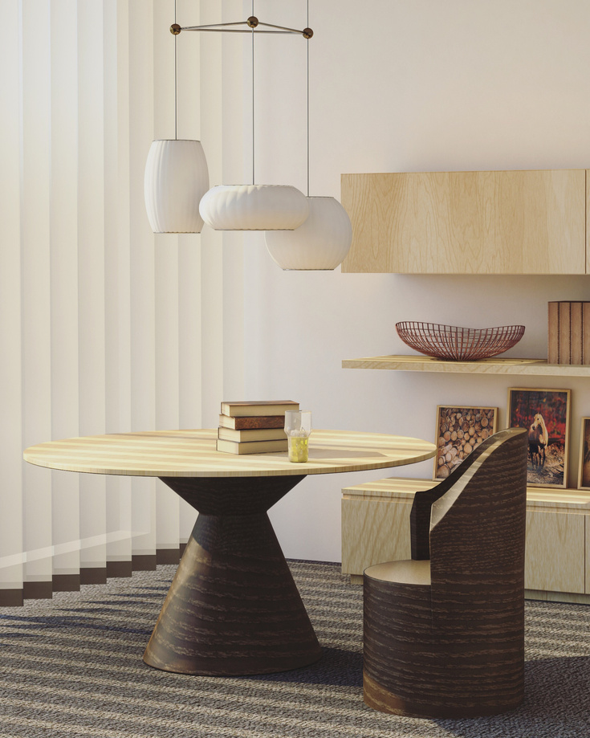
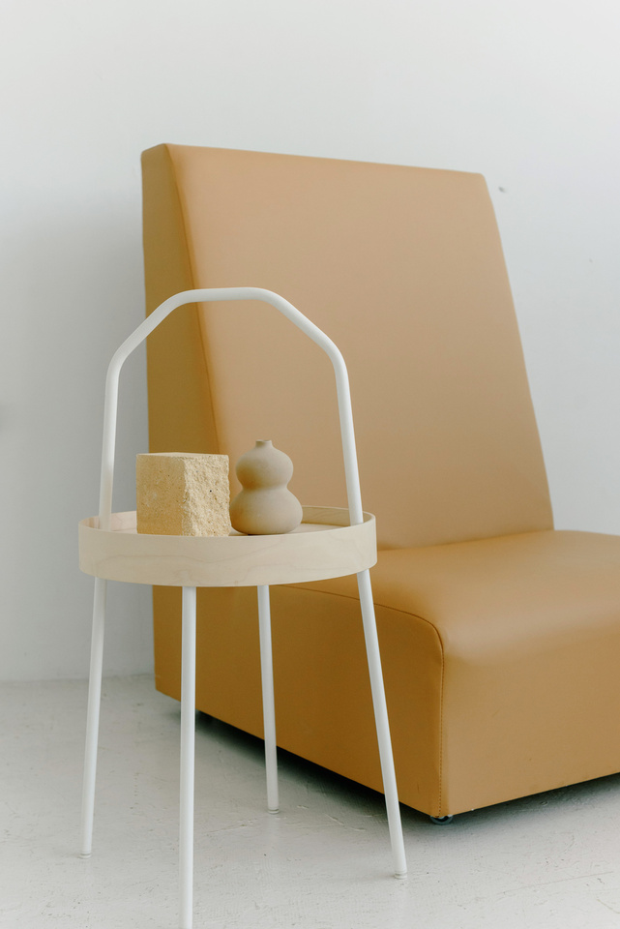
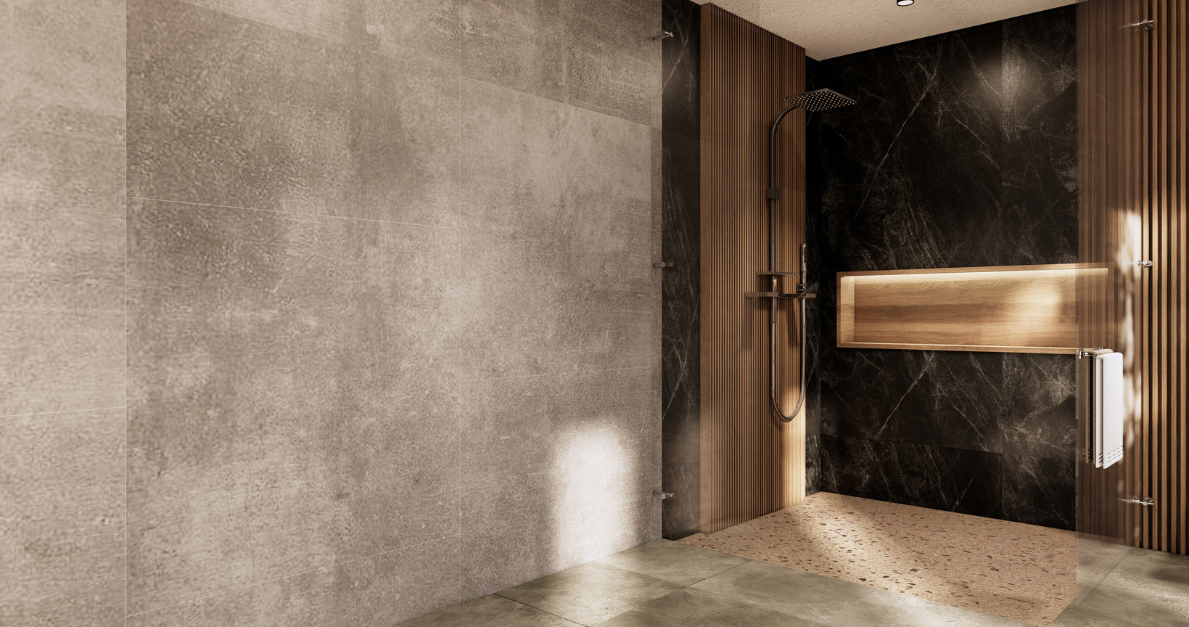
LARANA, INC.
2054
2054
02 What We Do
Our consultation service establishes your needs and what we will deliver to transform your space.
Fit-Out Consultation
Project Plan
and Schedule
We provide specialist expertise, including design concepts, specifications, and technical drawings.
Fair Project Budgeting
We believe that great interior design should be open to everyone, regardless of their budget.
Digital Project Rendering
We provide you with digital visualizations of your space to ensure you're completely happy with the design.

Slide 6
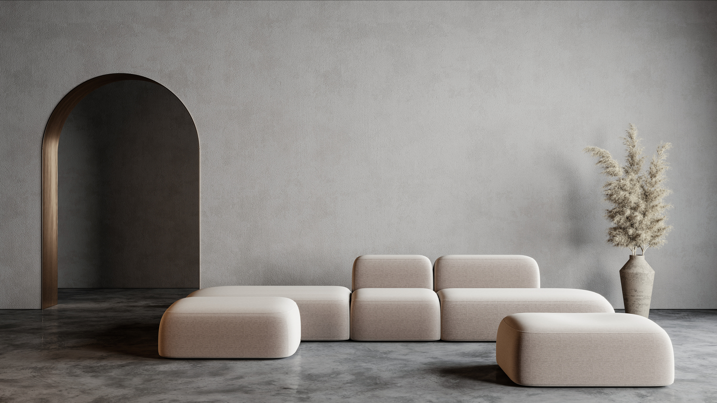
LARANA, INC.
2054
2054
As we evolve, our
homes should too.

Slide 7
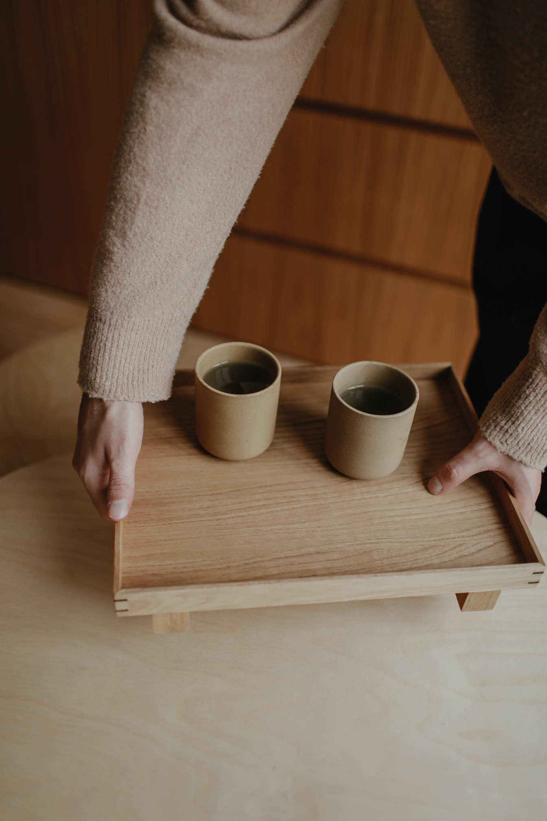
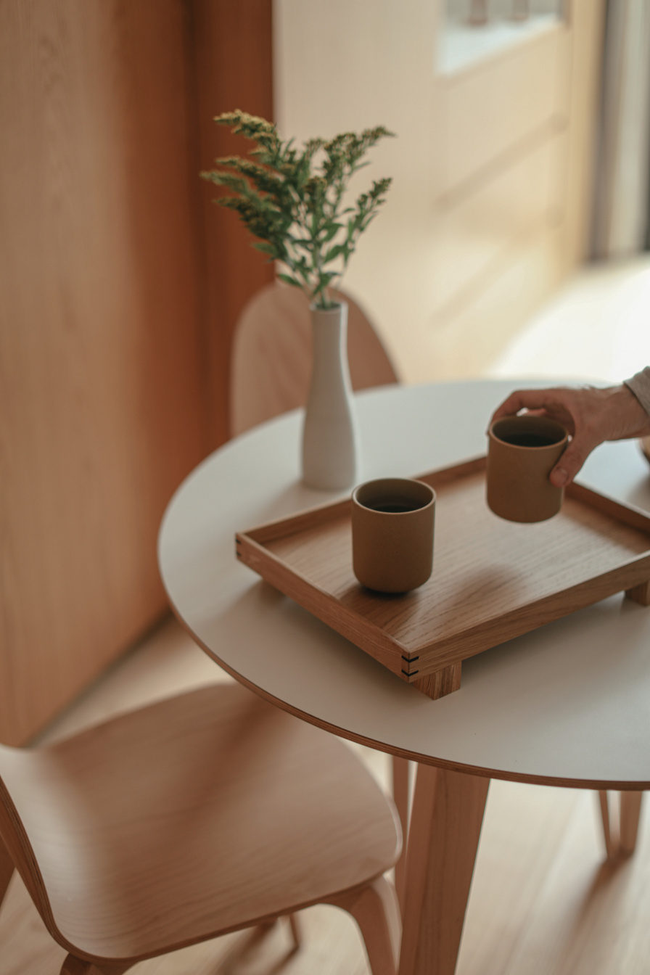
LARANA, INC.
2054
2054
03 Highlights
1956
1977
1998
Founded by Chad Gibbson and Olivia Wilson
The new office in Milan, Italy is opened.
The Stockholm office expands to a new location.
2019
2020
Winner of the iF Design Award for Best Interior Design.
Received the IDA award for Service to Interior Design.

Slide 8
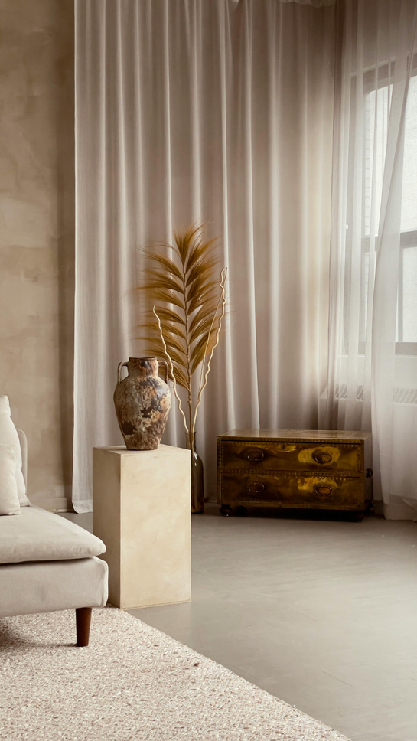
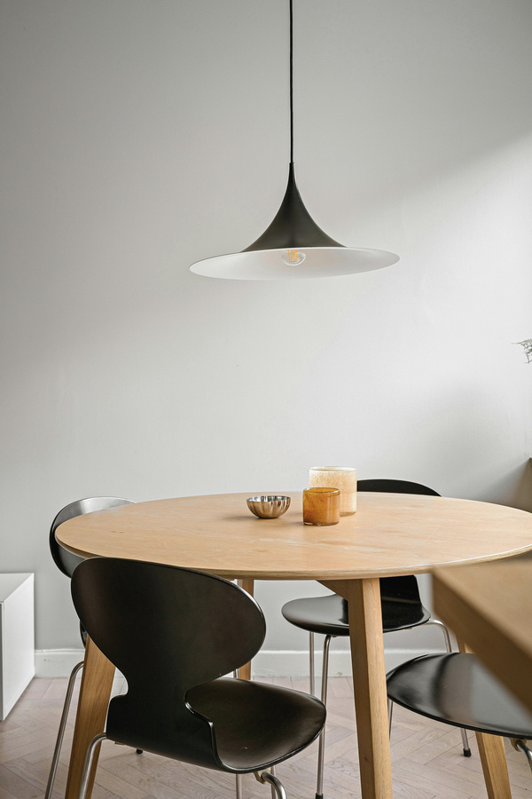
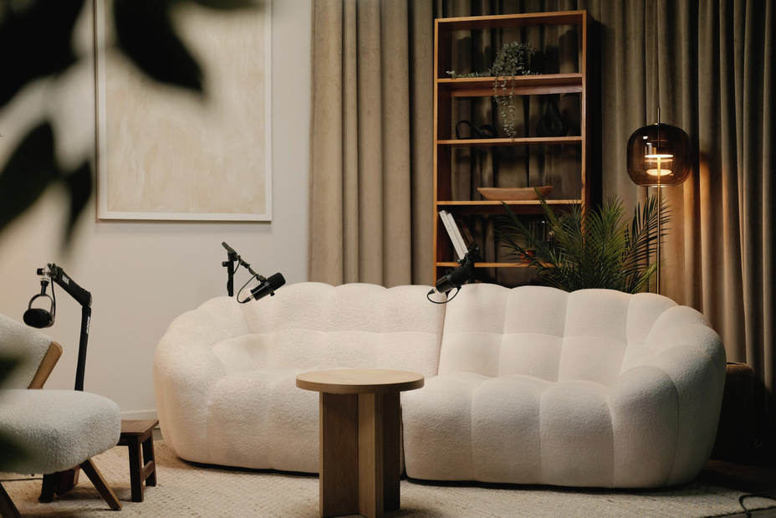
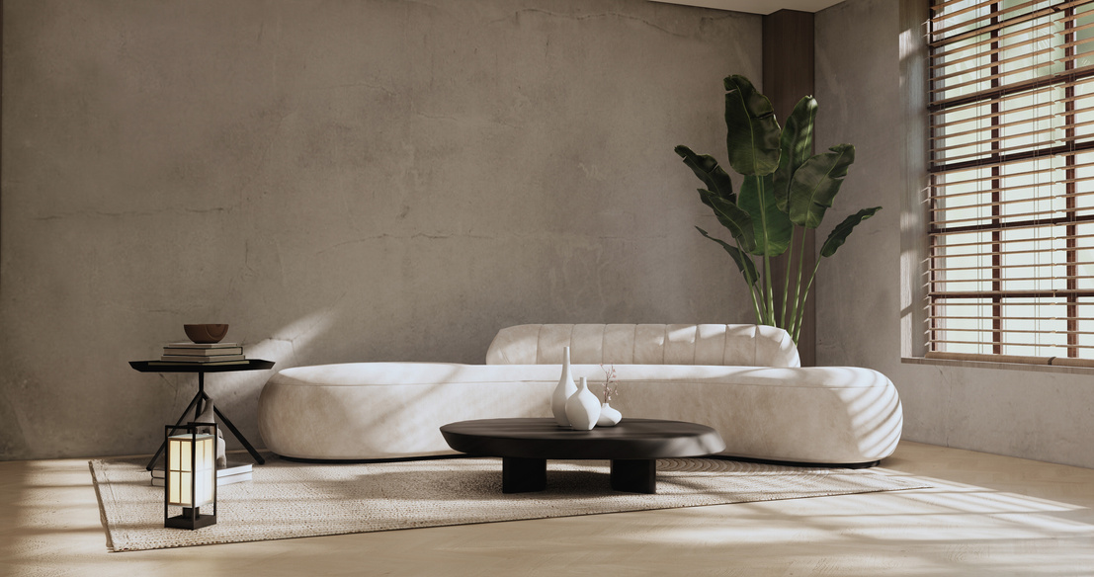
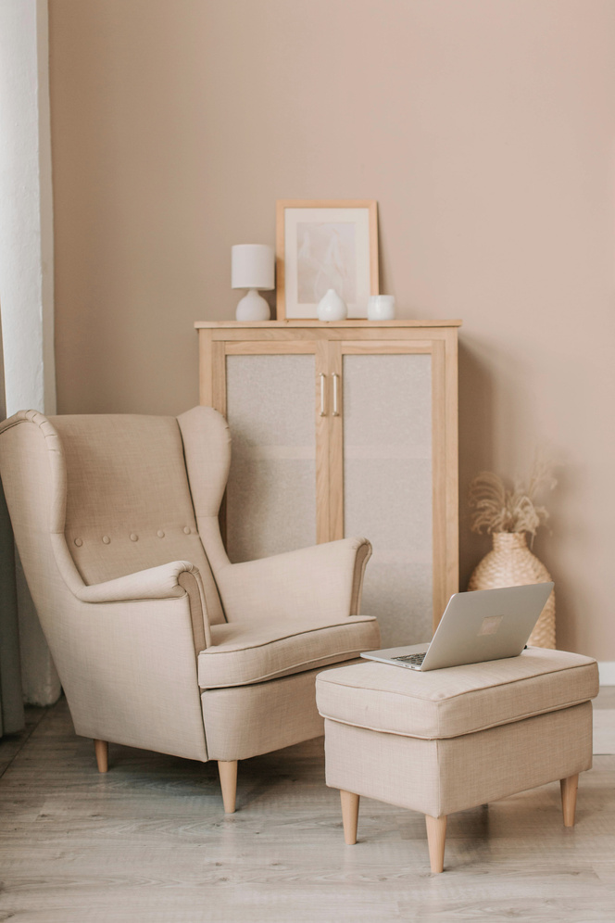
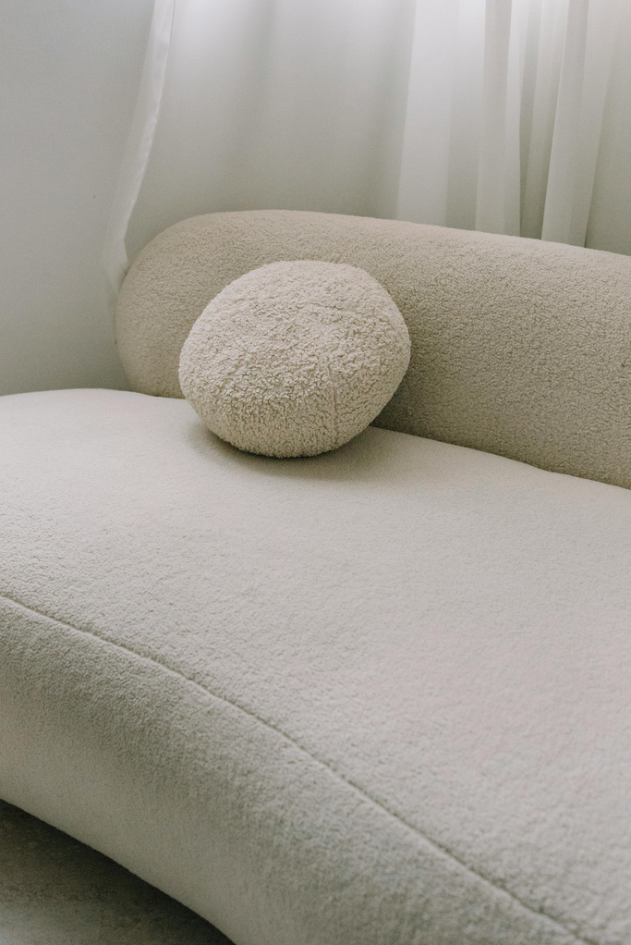
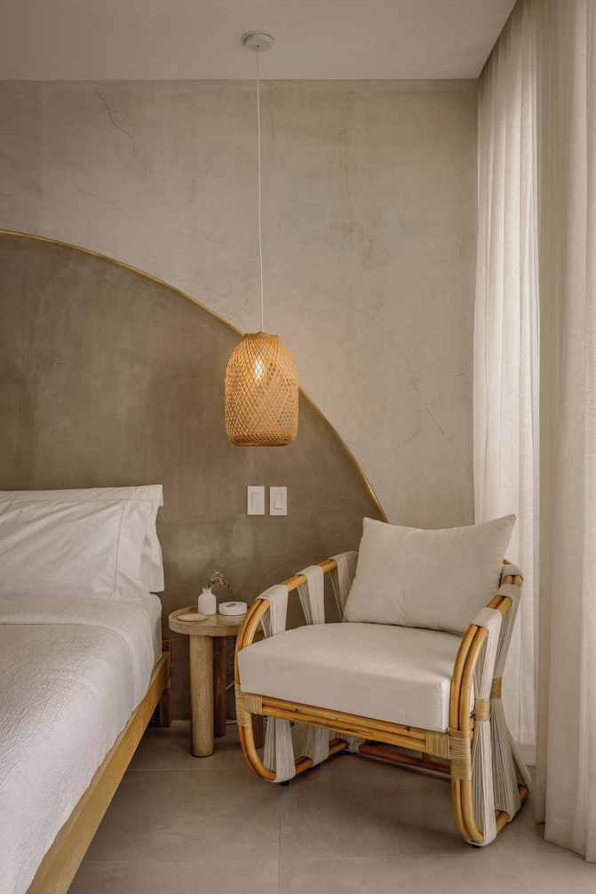
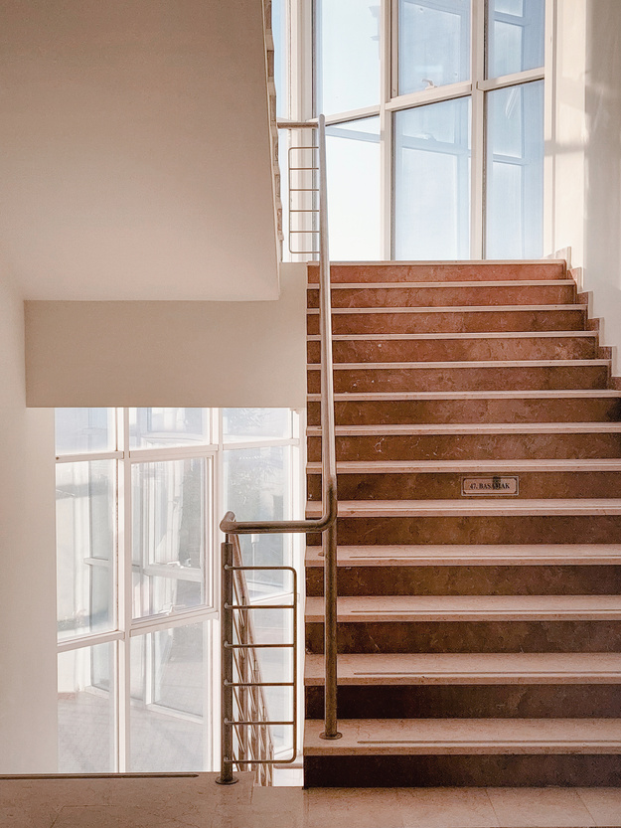
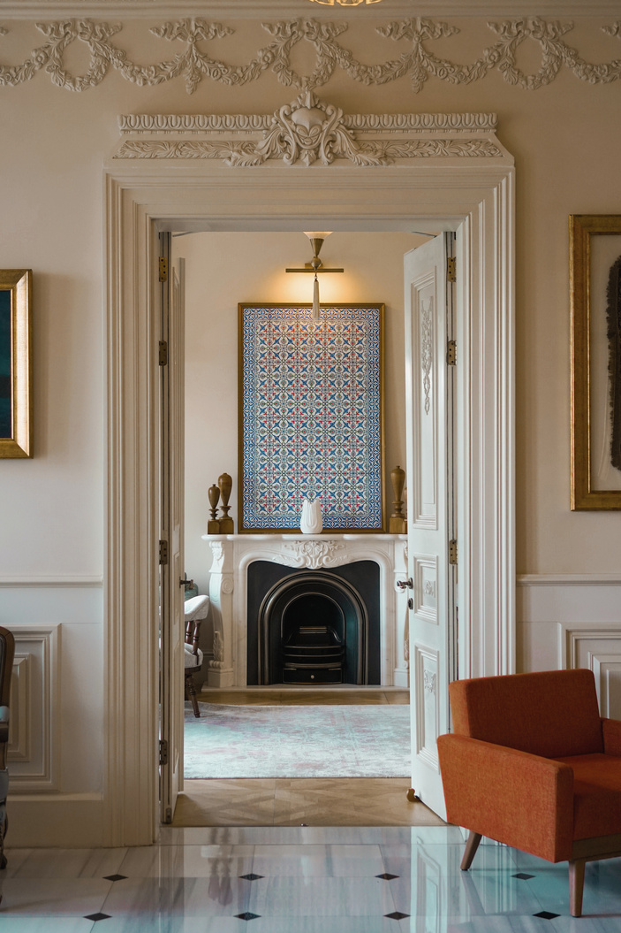
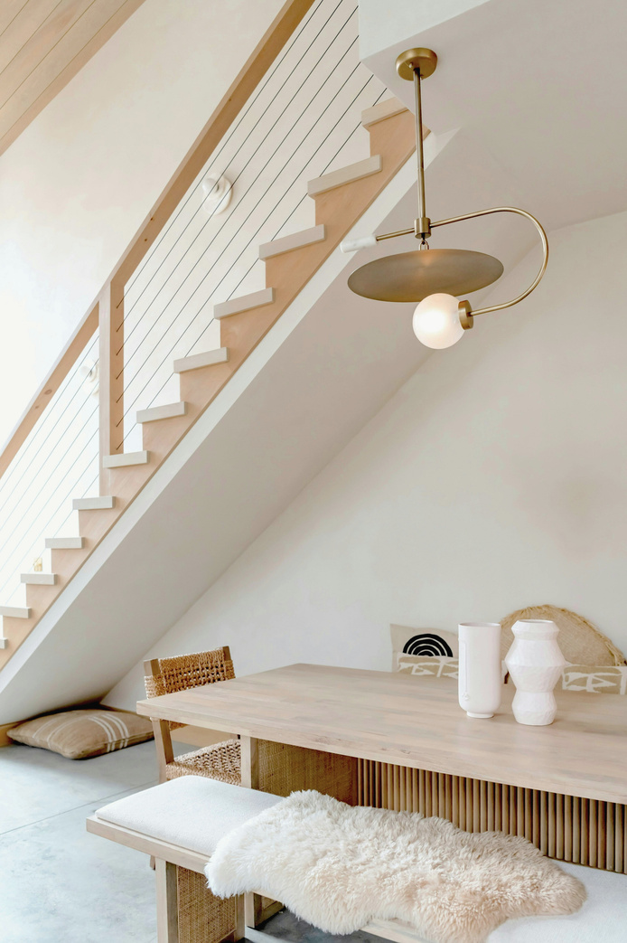
LARANA, INC.
2054
2054
04 Project Portfolio
Dec, 2001
Dec, 2002
Dec, 2006
Dec, 2008
Dec, 2013
Dec, 2018
Dec, 2024
Dec, 2032
Dec, 2038
Dec, 2044

Slide 9
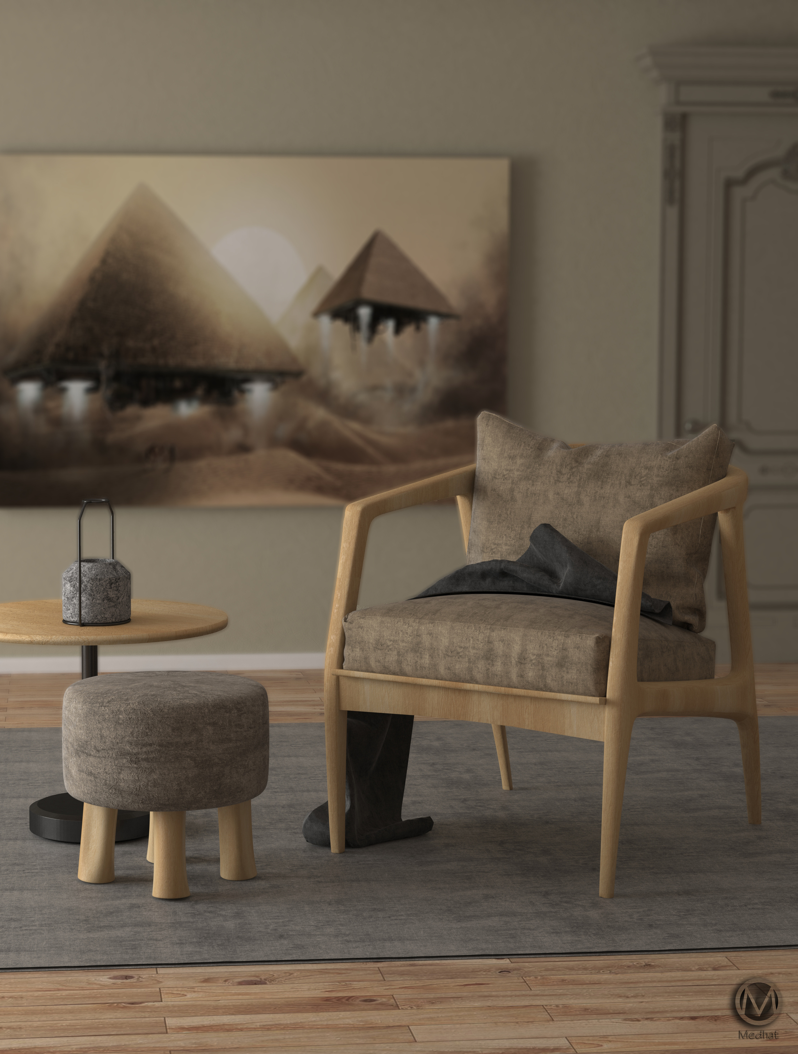
LARANA, INC.
2054
2054
05 How We Work
Meet
Research
New client meeting
Brief understanding
Brainstorming and preparation

Slide 10
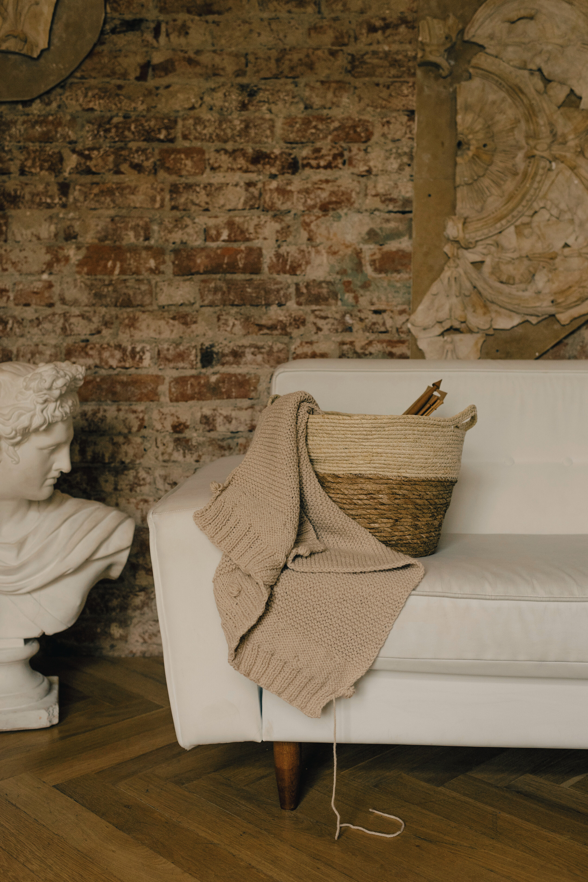
LARANA, INC.
2054
2054
Concept
Design
Finalize
Create
Install
Overall ideas and style generation
Layout and
style selection
Final design details and presentation
Project execution
within budget
Installation and
final touches

Slide 11
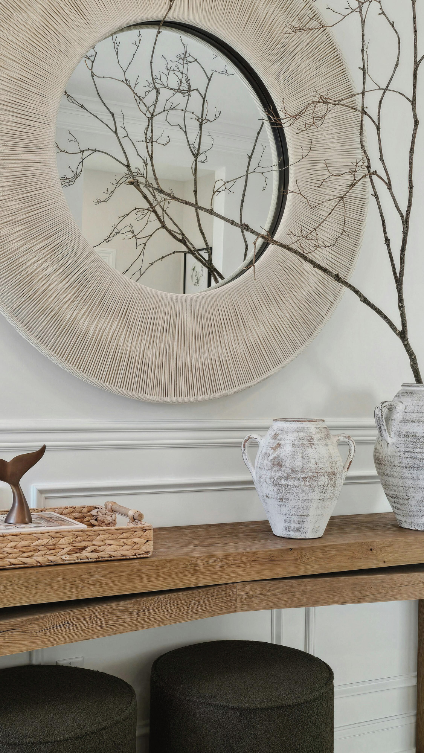
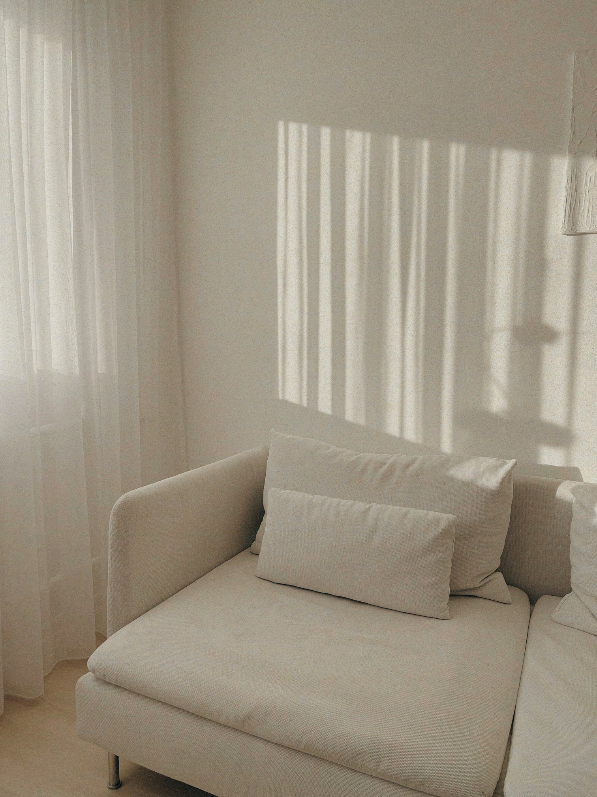
LARANA, INC.
2054
2054
06 Price list
Hourly
Square footage
Designer fee
The client will pay the designer
a competitive rate for each hour worked on the project.
More commonly, for commercial
spaces or new construction, clients
pay per square foot.
If the budget is established initially,
designer fees are paid at an agreed
percentage of the budget.
USD 150.00
PER HOUR
USD 45.00
PER SQ. FT.
20% OF PROJECT
BUDGET

Slide 12



LARANA, INC.
2054
2054
07 Meet Our Team
Chief Designer
An avid collector of Italian design objects. Clara is forever curious — she informs here work by observation and research while tapping into the potential of form and function. Her design moves beyond the conventional relationship between fashion, art, and design. With a passionate interest in the old and the modern, the traditional and the contemporary, she finds innovative solutions for any little or large spaces.
Olivia Wilson –

Slide 13





LARANA, INC.
2054
2054
Account Executive
Project Manager
Designer
Junior Designer
HR / GA
Teddy Yu–
Samira Hadid –
Rufus Stewert –
Reese Miller–
Aaron Loeb–

Slide 14
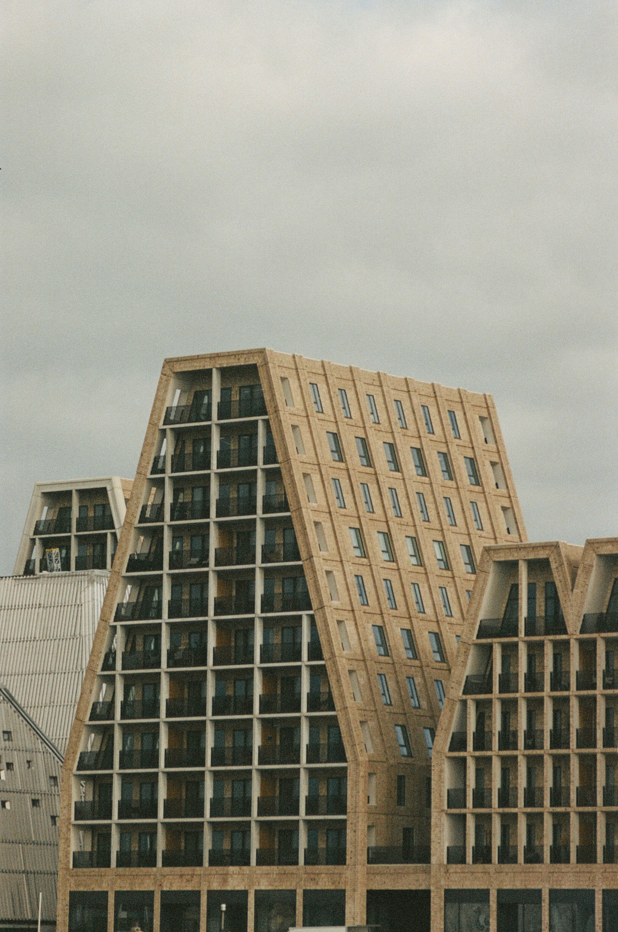
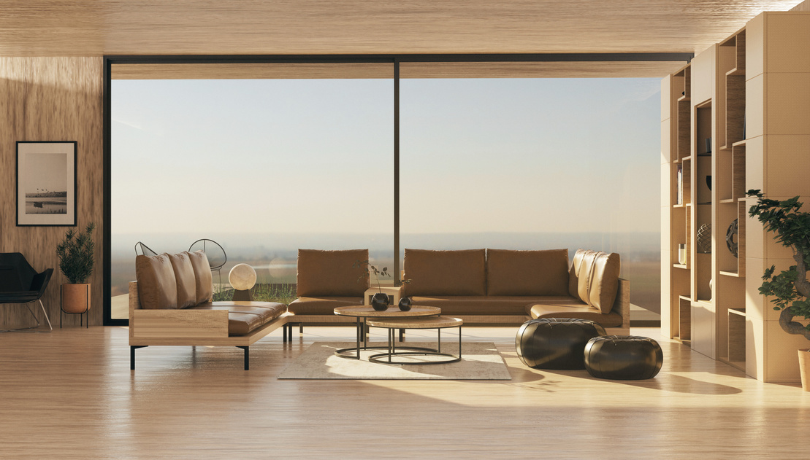
LARANA, INC.
2054
2054
Built to
Belong
Scandinavian architecture is defined by its simplicity, functionality, and deep connection to nature. Rooted in the Nordic landscape and way of life, it emphasizes clean lines, minimalism, and natural materials like wood, stone, and glass. The style prioritizes light, both natural and spatial, making interiors feel open, calm, and airy, even in the darkest months. With a focus on sustainability, craftsmanship, and timeless design, Scandinavian architecture blends beauty and purpose to create spaces that are both enduring and effortlessly livable.

Slide 15
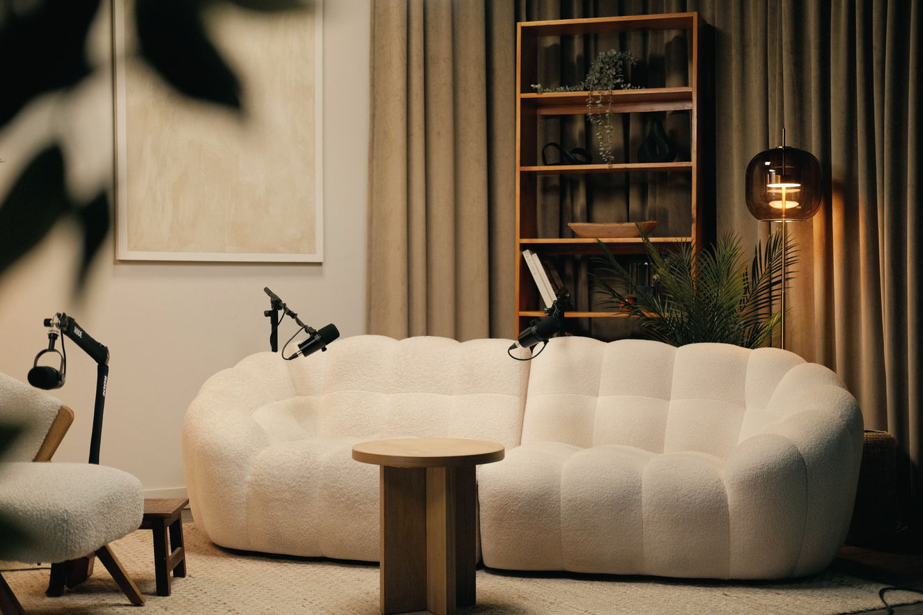
LARANA, INC.
2054
2054
09 Contact Us
Whether you’re redesigning a single room or developing a complete space from the ground up, we’d love to hear from you. At Larana, Inc., we specialize in thoughtful, functional, and timeless interiors tailored to your vision. Based in Sweden, we work with clients locally and internationally to bring spaces to life through Scandinavian design point of aesthetic sensibilities.
Conatct
Email
+123-456-7890
www.reallygreatsite.com
Address
Website
123 Anywhere St., Any City, ST 12345
hello@reallygreatsite.com
Behance
Instagram
Telegram

Slide 16
2054
Interior Design
Interior Design
Modern Minimal
Pitch Deck
Modern Minimal
Pitch Deck
LARANA, INC.

